Slide 1



















Tahaluf Copyright 2022- All Right Reserved
Harmony IT Solution
learning Hub
Web Application Programming Interface (API)
Tahaluf Training Center 2022

Slide 2



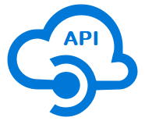





Tahaluf Copyright 2022- All Right Reserved
Harmony IT Solution
1
Overview Of ASP.NET Core
2
Why ASP.NET Core ?
3
Differences between ASP.NET Core and ASP.NET
4
Overview of ASP.NET Web API
5
5
Difference between MVC & Web API
7
6
8
8
9

Slide 3










Tahaluf Copyright 2022- All Right Reserved
Harmony IT Solution
Overview Of ASP.NET Core

Slide 4

Tahaluf Copyright 2022- All Right Reserved
Harmony IT Solution
ASP.Net Core is the latest version of Microsoft’s .NET Framework, which is a free, open-source, general-purpose development platform. It's a cross-platform framework that works with Windows, Mac OS X, and Linux.

Slide 5
Tahaluf Copyright 2022- All Right Reserved
Harmony IT Solution
Many applications can be made using ASP.NET Core, Such as Internet of Things (IoT) apps, web apps, and mobile backends. Can run on the cloud or on-premises.

Slide 6
Tahaluf Copyright 2022- All Right Reserved
Harmony IT Solution
Why ASP.NET Core ?

Slide 7

Tahaluf Copyright 2022- All Right Reserved
Harmony IT Solution
Architected for testability.
Cross-platform and Open-source.
A high-performance and lightweight framework.
Ability to host on Docker, Apache, IIS, and self-hosting.
A cloud-ready.
Built-in dependency injection.

Slide 8
Tahaluf Copyright 2022- All Right Reserved
Harmony IT Solution
DI (Dependency Injection) is a design pattern for software. It enables us to write code that is loosely coupled. Dependency Injection's goal is to make code more manageable. Dependency Injection helps in the reduction of tight coupling between program components. Dependency Injection eliminates hard-coded dependencies between your classes by injecting them at runtime rather than at design time.

Slide 9
Tahaluf Copyright 2022- All Right Reserved
Harmony IT Solution
Differences between ASP.NET Core and ASP.NET

Slide 10
Tahaluf Copyright 2022- All Right Reserved
Harmony IT Solution
BASED ON | .NET Core | .NET Framework
Open Source | .Net Core is an open source. | The .Net Framework contains a few open source components.
Cross-Platform | (cross-platform) compatible with various operating systems — Windows, Linux, and Mac OS. | compatible with the only windows operating system.
Application Models | . Net Core does not support the development of desktop applications; instead, it is focused on the web, Windows Mobile, and the Windows Store. | . The Net Framework is used to create desktop and web applications, and it also supports WPF and Windows Forms applications.

Slide 11
Tahaluf Copyright 2022- All Right Reserved
Harmony IT Solution
BASED ON | .NET Core | .NET Framework
Compatibility | .NET Core is compatible with various operating systems — Windows, Linux, and Mac OS. | .NET Framework is compatible only with the Windows operating system.
Packaging and Shipping | .Net Core software is distributed as a collection of Nugget packages. | The.Net Framework libraries are all packaged and provided as a single unit.

Slide 12
Tahaluf Copyright 2022- All Right Reserved
Harmony IT Solution
BASED ON | .NET Core | .NET Framework
Support for Micro-Services and API Services | Micro-services may be created and implemented using .Net Core, and a REST API is created in order to accomplish this. | While REST API services are supported by .Net Framework, microservice creation and implementation are not.
Performance and Scalability | High performance and scalability are advantages of.NET Core. | In terms of performance and application scalability,.Net Framework performs less effectively than.Net Core.

Slide 13
Tahaluf Copyright 2022- All Right Reserved
Harmony IT Solution
Difference between
MVC & Web API

Slide 14
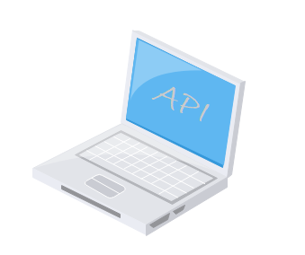
Tahaluf Copyright 2022- All Right Reserved
Harmony IT Solution
While Asp.Net MVC is used to build web applications that provide both views and data, Asp.Net Web API is used to quickly and easily create HTTP services that just return data.

Slide 15
Tahaluf Copyright 2022- All Right Reserved
Harmony IT Solution
Web API will also take care of returning data in a certain format, such as JSON, XML, or any other dependent on the Accept header in the request, so you don't have to bother about it. JsonResult is an MVC feature that exclusively returns data in JSON format.

Slide 16
Tahaluf Copyright 2022- All Right Reserved
Harmony IT Solution
Use ASP.Net MVC if you want to provide services that are only relevant to one application. On the other hand, if your business requirements require you to offer the functionality generally, you would desire a Web API approach.

Slide 17
Tahaluf Copyright 2022- All Right Reserved
Harmony IT Solution
While the request is mapped to actions in Web API based on HTTP verbs, it is mapped to action names in MVC.
Additionally, Web API is a lightweight design that may be utilized with mobile apps in addition to web applications.

Slide 18
Tahaluf Copyright 2022- All Right Reserved
Harmony IT Solution
The ASP.NET Web API is a framework for creating HTTP-based services that can be used in a variety of applications on a variety of platforms, including web, Windows, and mobile. It functions in a similar way to an ASP.NET MVC web application, except instead of sending an HTML view, it transmits data as a response.

Slide 19
Tahaluf Copyright 2022- All Right Reserved
Harmony IT Solution
To communicate with the Web API server, the ASP.NET Web API framework contains a new HttpClient. HttpClient may be used in ASP.MVC server-side applications, Windows Forms applications, Console applications, and other applications.

Slide 20
Tahaluf Copyright 2022- All Right Reserved
Harmony IT Solution
Overview of ASP.NET
Web API

Slide 21
Tahaluf Copyright 2022- All Right Reserved
Harmony IT Solution
What are RESTful Services?
REST represents a Representational State Transfer.
REST is an architectural pattern used to create an API that uses HTTP as a communication method.
REST specifies a collection of constraints that a system must adhere to.

Slide 22
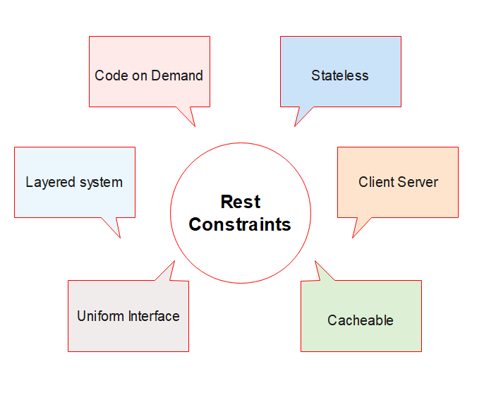
Tahaluf Copyright 2022- All Right Reserved
Harmony IT Solution

Slide 23
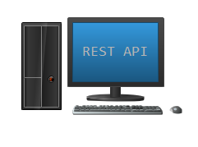
Tahaluf Copyright 2022- All Right Reserved
Harmony IT Solution
Client Server
A client sends a request, then a Server sends a response. This separation of concerns supports the independence and evolution of server-side logic and client-side logic.

Slide 24
Tahaluf Copyright 2022- All Right Reserved
Harmony IT Solution
Stateless
The communication between server and a client must be stateless.
The request from the client should contain all the information for the server needs it to complete a process.
Each request is treated independently by the server.

Slide 25
Tahaluf Copyright 2022- All Right Reserved
Harmony IT Solution
Cacheable
Every response should specify whether or not it can be cached on the client side as well as how long it may be cached there. For any subsequent requests, the client will return the data from its cache, eliminating the need to resend the request to the server.

Slide 26
Tahaluf Copyright 2022- All Right Reserved
Harmony IT Solution
Uniform Interface
It implies that there should be a standard way of interacting with a certain server regardless of the device or kind of application (website, mobile app).

Slide 27
Tahaluf Copyright 2022- All Right Reserved
Harmony IT Solution
Layered system
An application architecture must be composed of several levels. There are several intermediary servers between the client and the end server, and each layer has no knowledge of any layer other than its immediate layer.

Slide 28
Tahaluf Copyright 2022- All Right Reserved
Harmony IT Solution
Code on demand
It is an optional feature. Servers can also give executable code to clients, according to this such as JavaScript code.

